Slide 1
Acceptability Judgements on
Contrastive Dialogues
Involving ellipsis
Master’s thesis
Supervisors:
Prof. Dr. Michael Franke
Jun.-Prof. Dr. James Griffiths
Miriam Schiele
**DATUM***

Slide 2
Hypotheses
Study design
Results and revisiting hypotheses
Discussion
Background
The Influence of Metaphors
Contrastive Dialogues involving ellipsis

Slide 3
Background
A: Peter worked at the cinema FROM 6pm.
B: No, Peter worked at the cinema UNTIL 6pm.

Slide 4
Background

Slide 5
Hypotheses
Emphasis
Modality
Fragment type
Emphasis on contrasting words > dialogues lacking emphasis
Auditory stimuli > written stimuli
Lexical fragments > functional fragments

Slide 6
Study design: Factors
Emphasis
with
Modality
auditory
Fragment type
lexical
functional
without
written

Slide 7
Study design: Stimuli
with emphasis
A: Peter showed his ID to the POLICE OFFICER.
B: No, the BOUNCER.
A: Peter showed his ID to the police officer.
B: No, the bouncer.
without emphasis

Slide 8
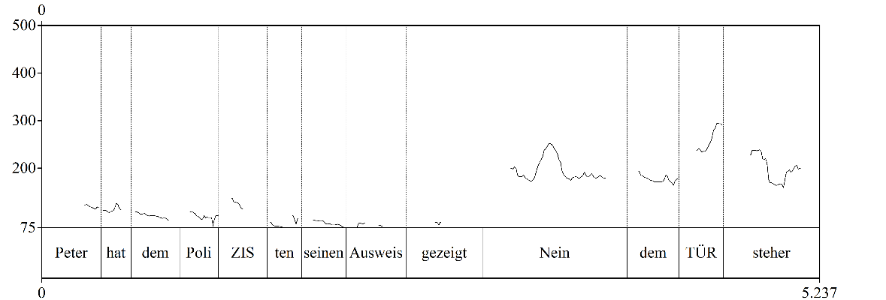
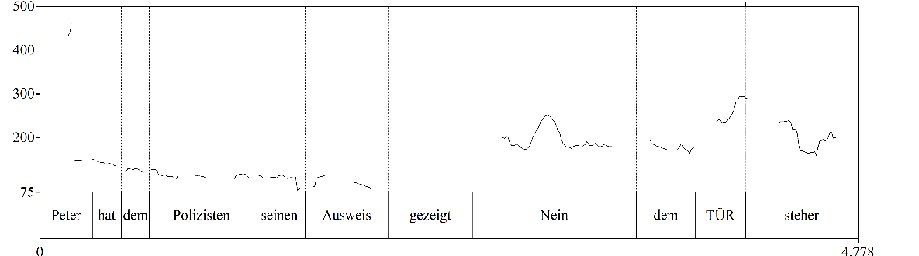
Study design: Stimuli
with emphasis
without emphasis

Slide 9
Study design: Stimuli
with emphasis
without emphasis

Slide 10
Study design: Stimuli
with emphasis
without emphasis

Slide 11
Study design: Stimuli
lexical
A: Peter showed his ID to the POLICE OFFICER.
B: No, the BOUNCER.
A: Peter worked at the cinema FROM 6pm.
B: No, UNTIL 6pm.
functional

Slide 12
Study design
modality
emphasis
fragment type
written
lexical
auditory
with emphasis
functional
without emphasis

Slide 13
Results

Slide 14
Discussion

Slide 15
TItle
Take home message
similar input with more effort:
crane neck / sit up

Slide 16










Title
title
question

Slide 17
title
multiplex signals
multimodal gestalt
Comparison A
Comparison B
x
x

Slide 18
Thank you for listening!

Slide 19

Discussion

Slide 20
References
Chu, x

